Slide 1
TangramTheatre: Creating Tangram Animation Cooperatively on a Large Interactive Tabletop
Prof. Yuanchun Shi 史元春
Dept. of Computer Science and Technology
Prof.Xiaobo Lu 鲁晓波
Academy of Arts and Design
Tsinghua University
April 09, 2013

Slide 2
Legal Notices
INFORMATION IN THIS DOCUMENT IS PROVIDED IN CONNECTION WITH INTEL® PRODUCTS. NO LICENSE, EXPRESS OR IMPLIED, BY ESTOPPEL OR OTHERWISE, TO ANY INTELLECTUAL PROPERTY RIGHTS IS GRANTED BY THIS DOCUMENT. EXCEPT AS PROVIDED IN INTEL’S TERMS AND CONDITIONS OF SALE FOR SUCH PRODUCTS, INTEL ASSUMES NO LIABILITY WHATSOEVER, AND INTEL DISCLAIMS ANY EXPRESS OR IMPLIED WARRANTY, RELATING TO SALE AND/OR USE OF INTEL® PRODUCTS INCLUDING LIABILITY OR WARRANTIES RELATING TO FITNESS FOR A PARTICULAR PURPOSE, MERCHANTABILITY, OR INFRINGEMENT OF ANY PATENT, COPYRIGHT OR OTHER INTELLECTUAL PROPERTY RIGHT. INTEL PRODUCTS ARE NOT INTENDED FOR USE IN MEDICAL, LIFE SAVING, OR LIFE SUSTAINING APPLICATIONS.
Intel may make changes to specifications and product descriptions at any time, without notice.
All products, dates, and figures specified are preliminary based on current expectations, and are subject to change without notice.
Intel, processors, chipsets, and desktop boards may contain design defects or errors known as errata, which may cause the product to deviate from published specifications. Current characterized errata are available on request.
[ADD ANY CODE NAMES FROM FOILS] and other code names featured are used internally within Intel to identify products that are in development and not yet publicly announced for release. Customers, licensees and other third parties are not authorized by Intel to use code names in advertising, promotion or marketing of any product or services and any such use of Intel's internal code names is at the sole risk of the user
Performance tests and ratings are measured using specific computer systems and/or components and reflect the approximate performance of Intel products as measured by those tests. Any difference in system hardware or software design or configuration may affect actual performance.
Intel, Intel Inside, [ADD ANY OTHER INTEL TRADEMARKS OR LOGO IN FOILS] and the Intel logo are trademarks of Intel Corporation in the United States and other countries.
*Other names and brands may be claimed as the property of others.
Copyright © 2009 Intel Corporation.

Slide 3
Outline
Motivation Exploration
Introduction to tangram
Ways for making animation
uTable
TangramTheatre
Making character
Combing Virtual and Reality
Define actions and patterns
Live show
Conclusion
Challenges

Slide 4
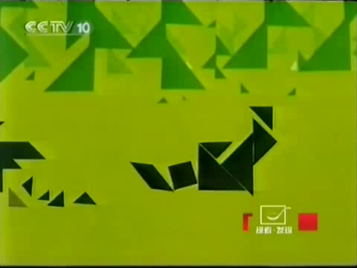
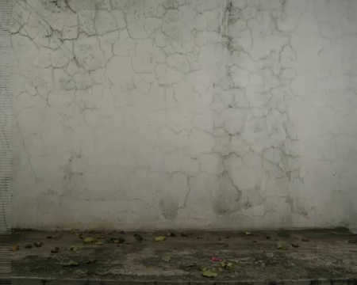
Motivation Exploration
Tom found some interesting animations
Waiting for another hare 守株待兔 Fight 功夫
Animation Features
Tangram-style （character appearance ）
Stop-Motion （animation style）

Slide 5
Motivation Exploration
Tom wants to make a similar animation. So, how?
Animation Features
Tangram-style （character appearance ）
Stop-Motion （animation style）

Slide 6
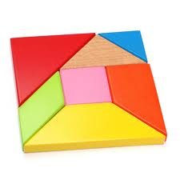

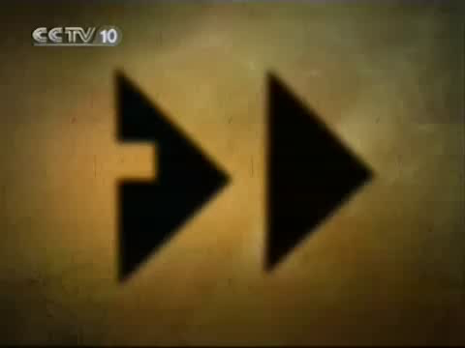


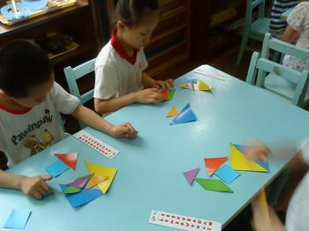
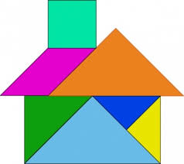
Motivation Exploration
Tom wants to make a similar animation. So, how?
Traditional Chinese toy：
Jigsaw Puzzles : put 7 pieces together to form shapes
with powerful creative expression
imagery thinking and creativity development
Animation Features
Tangram-style : special, challenging, and attractive
Stop-Motion （animation style）

Slide 7
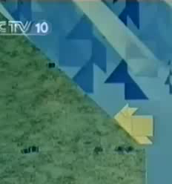
Motivation Exploration
Tom wants to make a similar animation. So, how?
Traditional Chinese toy：
Jigsaw Puzzles : Animation?
Animation Features
Tangram-style : special, challenging, and attractive
Stop-Motion （animation style）

Slide 8
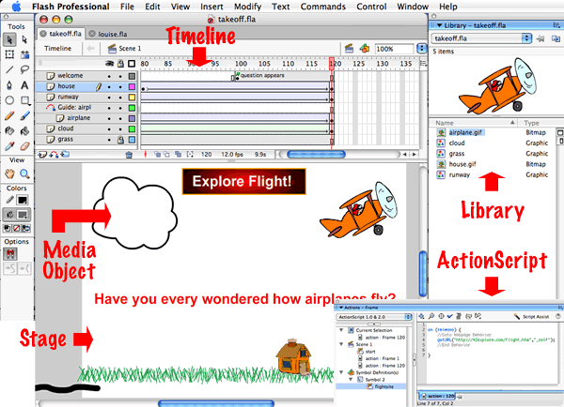
Motivation Exploration
Tom wants to make a similar animation. So, how?
Shooting frame by frame
Too trivial
Professional animation software
Flash, Animo, …
Unintuitive
Hard to learn
Animation Features
Tangram-style : special, challenging, and attractive
Stop-Motion （animation style）

Slide 9
Motivation Exploration
Tom wants to make a similar animation. So, how?
Is there any much easier way?
Make characters on table
Trigger actions through commands
Move characters by drawing paths
Support multi-user cooperation
Animation Features
Tangram-style : special, challenging, and attractive
Stop-Motion （animation style）

Slide 10
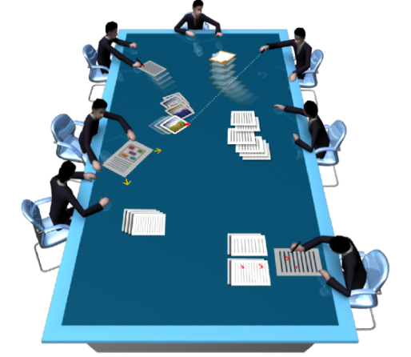
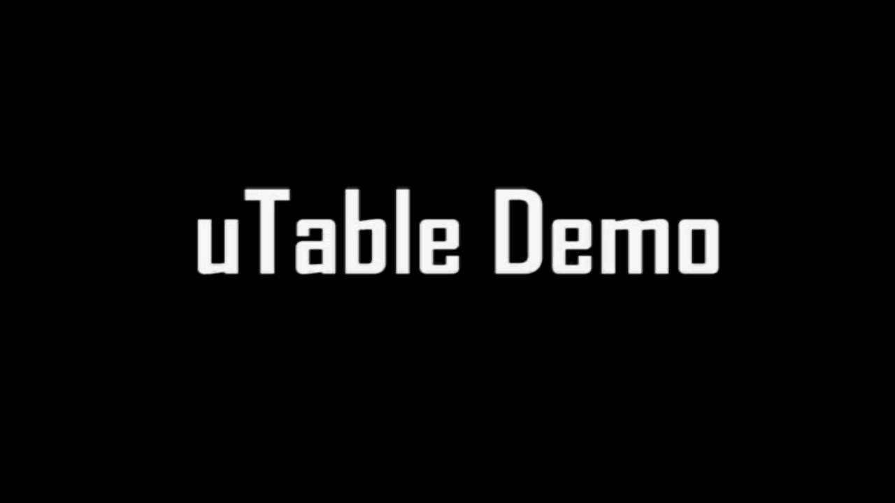
Tabletop!
Firstly, we need a “table”
uTable
Large scale interactive tabletop
4m*2m in size
3810*2048 in resolution
Multi-model input methods
Touch, Marker…
Multi-user
Similar with a real physical table
And next?
We need a “TangramTheatre” on the uTable.

Slide 11
Outline
Motivation Exploration
Introduction to tangram
Ways for making animation
uTable
TangramTheatre
Making character
Combing Virtual and Reality
Define actions and patterns
Live show
Conclusion
Challenges

Slide 12
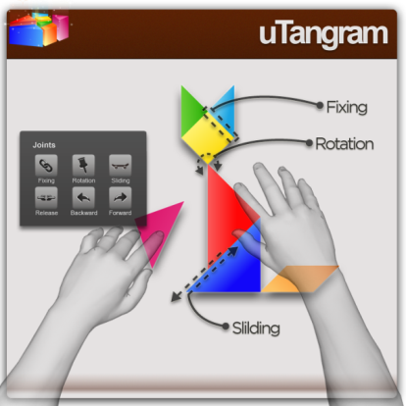
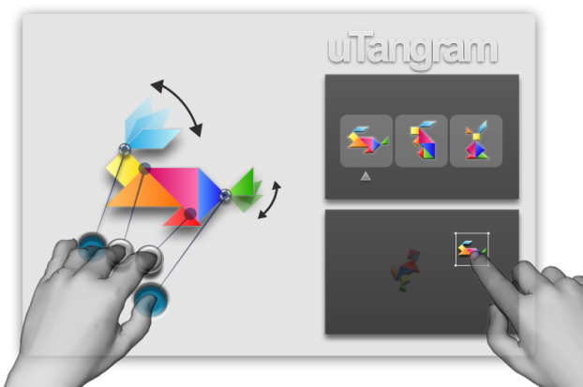
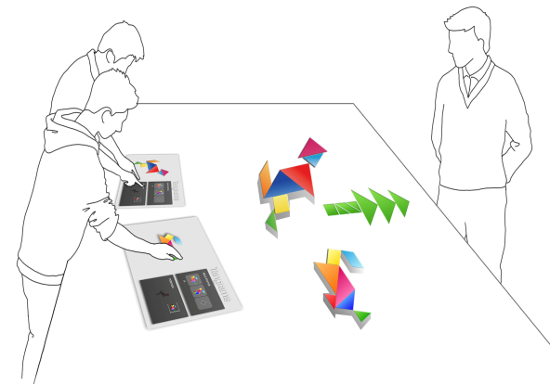
TangramTheatre
The process of making animation
Making Characters
Pre-Define Action and Pattern
Perform

Slide 13

Making Characters
Moving pieces by multi-touch
Adding joints to connect each pieces
E.g. Binding, Pivot, Slider
Changing colors according to needs
Must we make characters only through virtual pieces?

Slide 14
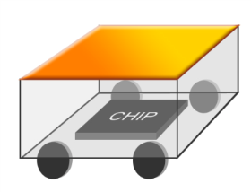
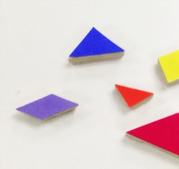
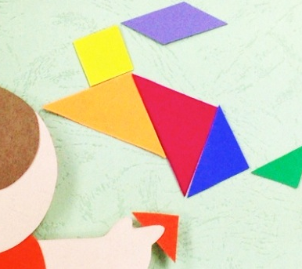
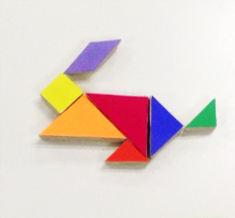
Making Characters
And what if we have a “car” on uTable
One stands a piece of a set of tangram
Seven pieces constitute a character
Two way of making characters
Moving real physical pieces
Touching virtual pieces
Physical ones will form the same characters with the virtual.

Slide 15
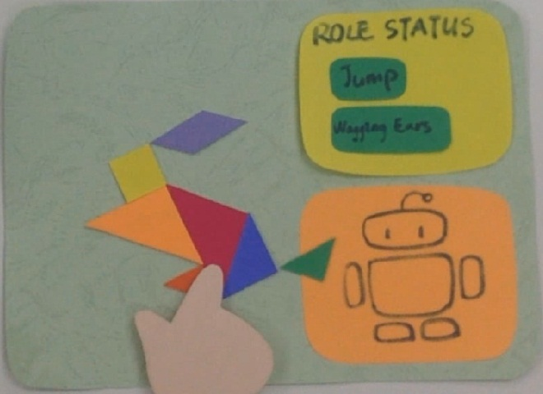
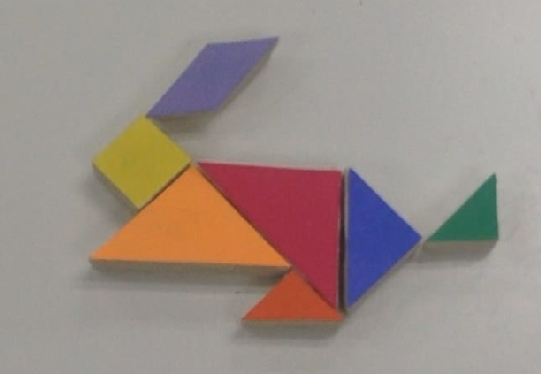
Define actions and patterns
Pre-define actions and patterns
Trigger actions by pressing buttons
Switch between patterns with little time
Drag it to the stage
Each virtual character can have a corresponding real one.

Slide 16
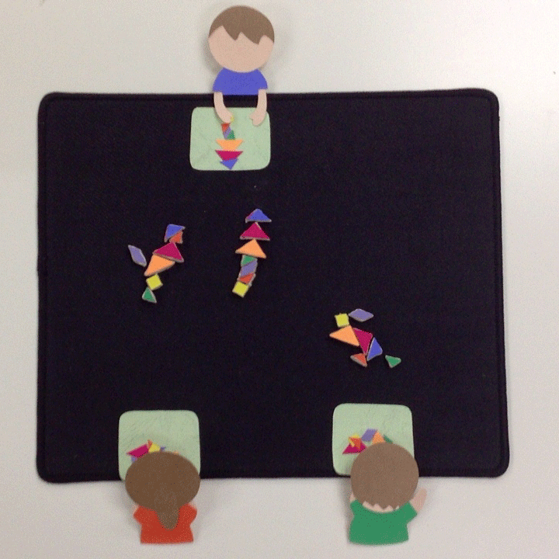
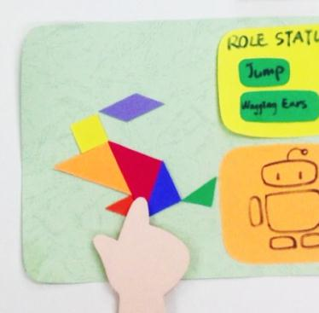
Live Show
Finally, making animation on uTable
Multi-user
Combining virtual and real
Intuitive and natural
Easy to control

Slide 17
Conclusion
TangramTheatre
New medium for tangram-style animation
Combining virtual and reality
More intuitive and natural operation way
Supporting multi-user cooperation
Live show and engaging with audience at the same time

Slide 18
Challenges
How to define the connections between each pieces
How to differentiate each pieces
How to make physical pieces automatically form characters without collision of pieces
How to trigger several actions simultaneously
How to control physical characters’ movement accurately considering friction and other factors
How to design a better system for perfect cooperation between users

